Slide 1

Project Title – Seasonal Agriculture Performance Data Analytics
[Student Name- Harsh Sharma
College Name-Institute of Technology & Science ]
AICTE STU ID : STU666a218d488df1718231437

Slide 2

PROBLEM STATEMENT
(Agricultural activities are influenced by seasonal variations in environmental conditions, farming practices, resource availability and market conditions. As a result, agricultural performance may differ from one season to another. However, raw agricultural data does not clearly explain how agricultural performance changes across seasons or what patterns can be observed in different seasonal conditions. The problem is to analyze the given agricultural dataset and investigate seasonal differences in agricultural performance by identifying meaningful patterns, trends, relationships and variations within the available data.

Slide 3
Project Description
This project evaluates how seasonal variations directly impact farm-level performance and financial outcomes across India. Working with a dataset of 4,000 individual farm records, the goal is to surface practical patterns in crop yield, resource usage, and profitability across different growing cycles using pure exploratory data analysis—no predictive machine learning or complex dashboards required.
Project Overview & Objectives
Agricultural success fluctuates dramatically with climate changes, resource availability, and input management. This project breaks down those relationships across the Kharif, Rabi, and Zaid cropping seasons to understand what actually drives productivity and profit on the ground.
Data Quality & Preparation: Clean missing values in critical columns like rainfall, soil moisture, and crop yield to ensure accurate baseline metrics.
Seasonal Performance Breakdown: Compare total crop yields, production volume, and market revenues across different seasons to highlight seasonal trends.
Input Interdependence Analysis: Measure how environmental conditions (temperature, rainfall, sunlight) and soil nutrients (nitrogen, phosphorus, potassium) interact with farm output.
Resource & Profitability Assessment: Evaluate the financial return against water consumption efficiency across drip, flood, sprinkler, and rainfed irrigation systems.
Dataset & Key Metrics
The analysis is built on seasonal_agriculture_performance_dataset.csv, comprising 4,000 records across 28 distinct numerical and categorical variables:
Location & Categorical Features: State, District, Crop (Wheat, Rice, Maize, Pulses, Cotton, Chilli), Season, and Irrigation Method.
Environmental & Soil Dynamics: Rainfall (mm), Average Temperature (°C), Humidity (%), Daily Sunlight Hours, Soil pH, Soil Moisture (%), and N-P-K nutrient ratios.
Operational Inputs & Financial Outputs: Fertilizer and pesticide application rates, Seed Quality Score, Yield (Tonnes/Ha), Total Costs, Revenue, Net Profit (INR), Water Used ($m^3$), Water Efficiency, and Pest Risk percentages.
Tools & Workflow
The analysis is implemented in Python, leveraging Pandas and NumPy for data manipulation and statistical summaries, alongside Matplotlib and Seaborn for visual exploration. The workflow progresses from univariate distribution checks (identifying outliers in costs and yield spikes) to bivariate seasonal groupings, ending with multivariate correlation analysis to isolate the primary levers of high farm profitability.

Slide 4

WHO ARE THE END USERS?
The end users of this project fall into two main categories based on the notebook's technical scope and agricultural focus:
Primary Technical Users (Notebook Execution)
Students & Data Analytics Learners: The direct hands-on users responsible for loading the dataset, conducting exploratory data analysis, and building visual, evidence-based reports.
Business & Stakeholder End Users (Insight Consumers)
Farmers & Farm Managers: Benefit from data-driven findings on seasonal yield variations, optimal fertilizer/pesticide usage, water efficiency, and profitability to plan cropping cycles effectively.
Agricultural Policy Makers & Government Agencies: Rely on regional performance patterns, soil health data, and water-use insights to guide irrigation planning, subsidy distribution, and pest management policies.
Agribusinesses & Financial Institutions: Use insights into crop market prices, input costs, disease risks, and profit margins to optimize supply chains, agricultural loans, and crop insurance products.

Slide 5

Technology Used
Core Language Used: Python
Data Manipulation & Analysis: Pandas, NumPy Liabrary
Data Visualization: Matplotlib, Seaborn Liabrary
Execution Environment: Jupyter Notebook IDE

Slide 6
RESULTS
The dataset contains 4,000 agricultural farm records across 28 variables designed to analyze seasonal farming performance in India.
Dataset Overview
Scale: Tracks 4,000 individual farm records (Farm_ID) spanning 8 States and 10 Districts.
Feature Scope: Captures environmental metrics (rainfall, soil pH, moisture), farm inputs (fertilizer, seed quality, irrigation), and financial outcomes (costs, revenue, profit).
Data Quality & Missing Values
Completeness: 25 out of 28 columns have complete data with no missing entries.
Missing Data: Small gaps exist in Rainfall_mm (48 missing), Soil_Moisture_pct (40 missing), and Yield_Tonnes_Ha (32 missing).
Categorical Highlights
Seasons: Covers 3 farming seasons, with Kharif being the most frequent (1,779 farms).
Crops: Evaluates 8 crop types, led by Rice as the most sampled crop (690 farms).
Geography & Irrigation: Andhra Pradesh is the most frequent state recorded (529 farms), and Flood irrigation is the most common watering technique (1,310 farms).
Key Statistical Averages
Farm Size: Averages 7.89 hectares, ranging from 0.50 to 15.00 hectares.
Climate Conditions: Mean rainfall is 601.15 mm, average temperature is 26.82°C, and average humidity is 63.21%.
Yield & Output: Average yield is 5.27 tonnes per hectare, driving an average overall production of 43.25 tonnes per farm.
Financial Profile: Mean revenue per farm is ₹637,860 against average costs of ₹526,304, yielding an average profit of ₹111,556. However, median profit is significantly lower at ₹3,673, indicating severe financial distribution skew and profitability variations across farms.

Slide 7
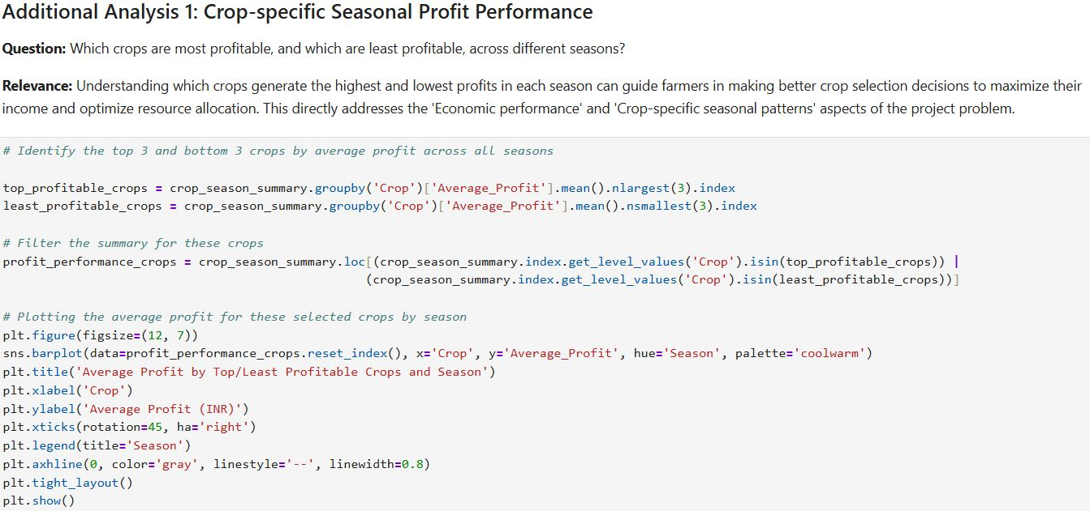
RESULTS
[Add screen shots of your code ]

Slide 8
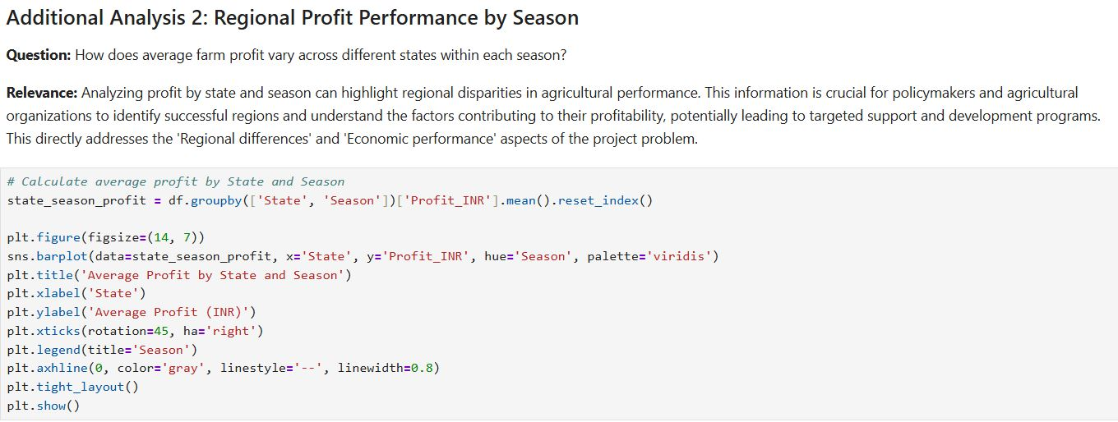
RESULTS
[Add screen shots of your code ]

Slide 9
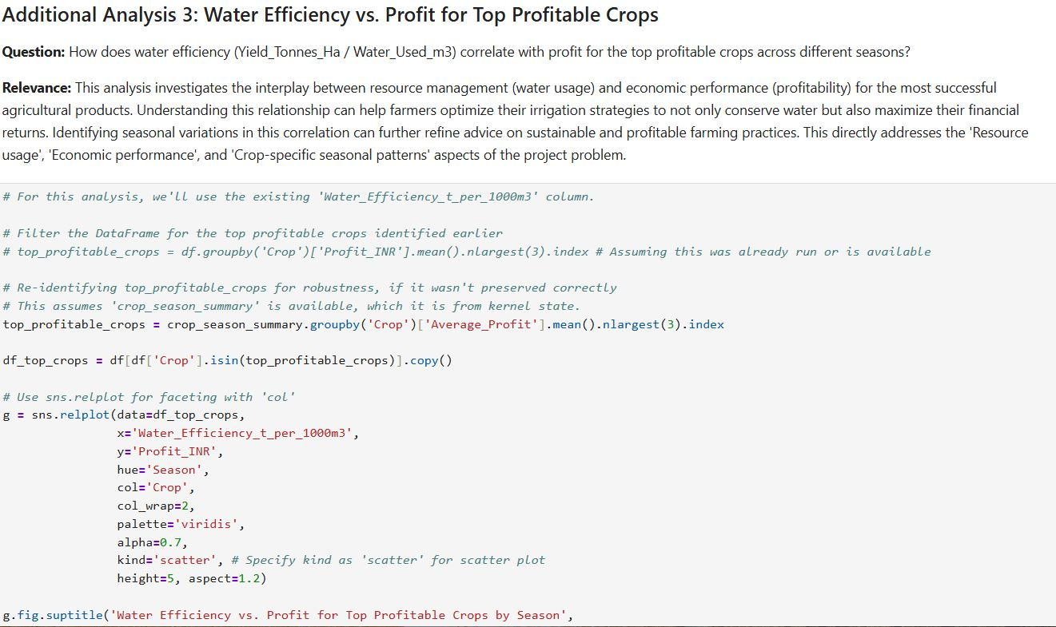
RESULTS
[Add screen shots of your code ]

Slide 10
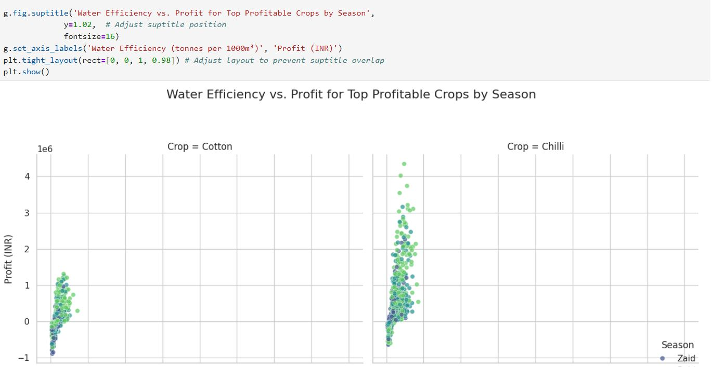
RESULTS
[Add screen shots of your code ]

Slide 11
Future scope
This analysis provides a foundational understanding for future investigations and supports decision-making in several ways:
Strategic Crop Planning: Farmers can use these insights to make more informed decisions about which crops to plant in which season to maximize profitability and minimize risk.
Resource Allocation: Policymakers and agricultural organizations can use the regional and seasonal performance data to target support programs, investment in irrigation infrastructure, and research efforts more effectively.
Sustainable Practices: The emphasis on water efficiency can guide initiatives for promoting sustainable farming practices and technology adoption.
Further Research: The identified patterns and limitations highlight areas for deeper investigation, such as the specific reasons behind Zaid season losses, the cost-benefit analysis of drip irrigation, or the impact of environmental variables on crop-specific yields. It also sets the stage for more advanced predictive modeling.

Slide 12
GitHub Link
https://github.com/harsh0012300-cloud/VOIS-MAJOR-PROJECT.git

Slide 13
VOIS Course completion certificate - Course name- Data Visualization

Slide 14
Thank you
[Student Name- Harsh Sharma
College Name-Institute of Technology & Science ]
AICTE STU ID : STU666a218d488df1718231437
.
.

